Slide 1
Valuation of Bonds & Stocks

Slide 2
Bond Valuation:
Liquidation value:
Liquidation Value is the amount that can be realised when an asset, or a group of assets representing a part or even the whole of a firm, is sold separately from the operating organisation.
Going Concern Value
Going concern represents the amount that can be realised if the firm is sold as a continuing operating entity.
Book value
Book value of an asset is the accounting value of the asset, which is simply the historical cost of the asset less accumulated depreciation or amortisation as the case may be . The book value of a firm’s equity is equal to the book value of its assets minus the book value of its liabilities.
Market Value
Market value of an asset is simply the market price at which the assets trade in the market place. Often Market value is greater than the book value.
Intrinsic Value
Intrinsic value of a security is the present value of the cash flow stream expected from the security, discounted at a rate of return appropriate for the risk associated with the security.

Slide 3
Bonds issued by central Government are called Treasury Bonds. These bonds which have maturities ranging up to 20 years. These bonds generally pay interest semi – annually. Presently, Treasury bonds dominate the Indian bond market in terms of market capitalisation, liquidity and turnover.
State government bonds are issued by the state governments. These bonds have maturities that generally range from 3 to 20 years and pay interest semi – annually .
PSU (Public Sector undertakings) bonds are bonds issued by companies in which state and central governments have equity stake in excess of 50%. Some of these bonds enjoy tax free status whereas others are taxable.
Private Sector bonds are bonds issued by private sector companies.
Bonds issued by companies, PSU bonds as well as private sector bonds, generally have maturity ranging from 1 year to 15 years and pay interest semi – annually.

Slide 4
Bond Terminologies:
Par Value: This is the value stated on the face of the bond.
Coupon rate and interest: A bond carries a specific interest rate which is called ‘the coupon rate’.
The interest payable to the bondholder is
Par value of the bond X coupon rate.
Maturity Period:
Typically bonds have a maturity period of 1-15 years . At the time of maturity the par ( face ) value + nominal premium is payable to the bond holder.

Slide 5
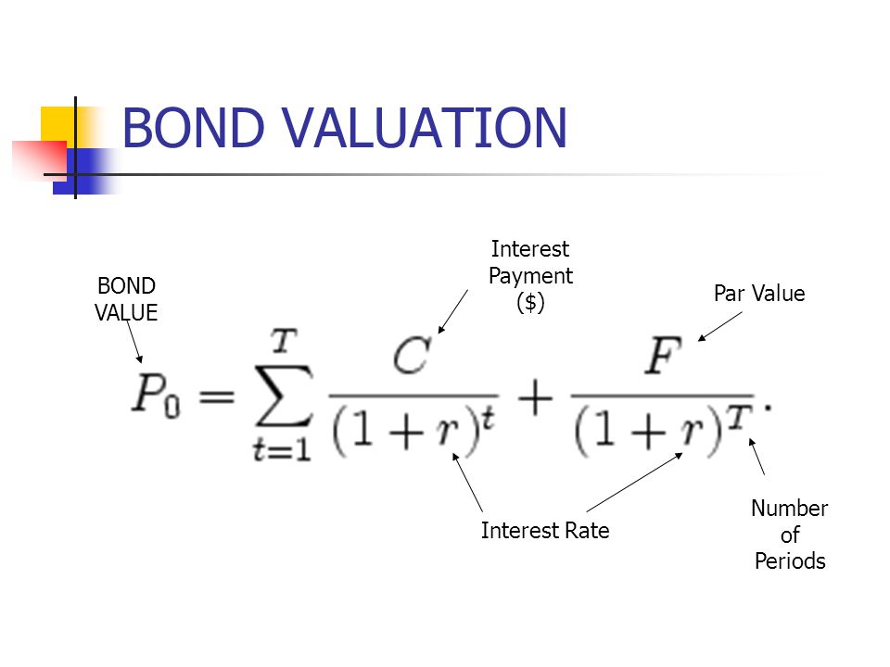
n
n

Slide 6
Bond Valuation :
P = C X PVIFA _{(r,n)} + M X PVIF _{(r,n)}
Example:
A bond of 10 year, 12% Coupon with par value of ₹ 1000. Let us assume required yield on this bond is 13%. Calculate the Value of bond.
C= 1000 * 12% = 120
n = 10 year
r = 13%
P = 120 * PVIFA _{(13%, 10 yrs)} + 1000 * PVIF _{(13%, 10 yrs)}
P = 120 X 5.426 + 1000 X 0.295
P = 651.1 + 295 = ₹ 946.1

Slide 7
Exercise:
A 100 par value bond, bearing a coupon rate of 11% will mature after 5 years. What is the value of the bond, if the discount rate is 15%?
( Answer : ₹ 86.7)
2. A ₹ 100 par value bond, bearing a coupon rate of 12%, will mature after 7 years. What is the value of the bond if the discount rate is 14%? 12% ?
( Ans : ₹ 91. 46 if discount rate is 14%
₹ 100 if discount rate is 12%. )

Slide 8
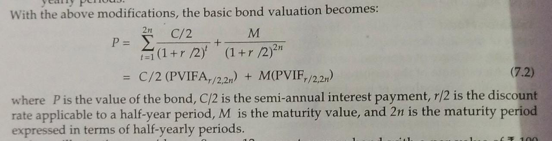
Bond value with Semi – annual interest :
Note:
C/2 , r/2 and n*2 in the above 2 formulas.

Slide 9
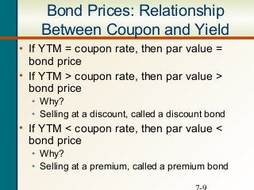

Slide 10
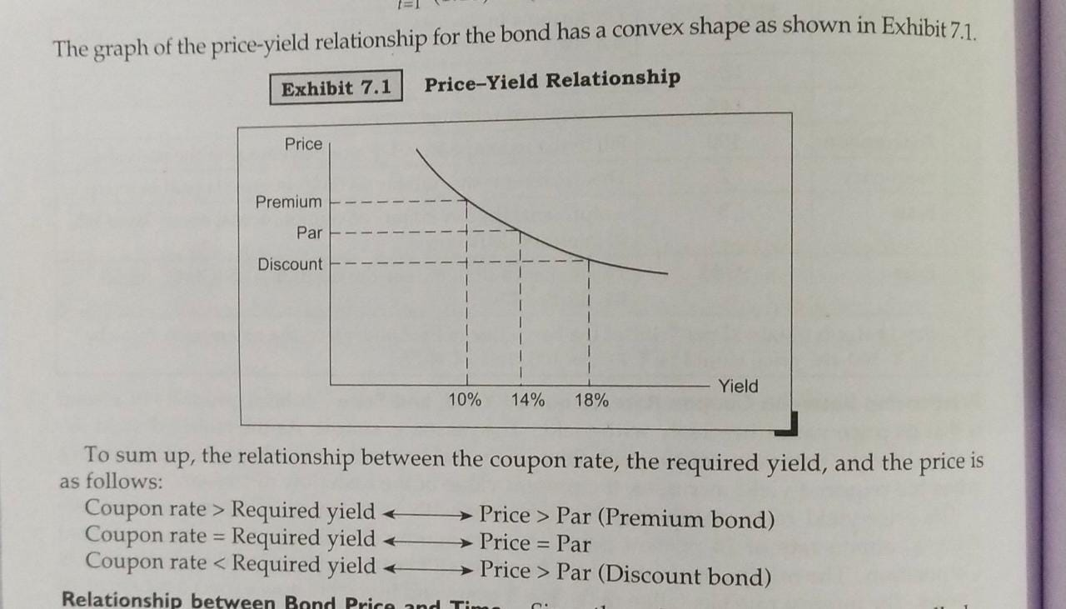

Slide 11
Exercise:
1. A Rs. 100 par value bond bears a coupon rate of 12% and matures after 6 years. Interest is payable semi – annually. Compute the value of the bond if the required rate of return is 16%, compounded semi – annually.
( Ans: ₹ 84.92)
2. A company’s bonds have a par value of ₹ 100, mature in 7 years, and carry a coupon rate of 12% payable semi – annually. If the appropriate discount rate is 16%, What price should the bond command in the market place?
(Ans: ₹ 83.56)

Slide 12
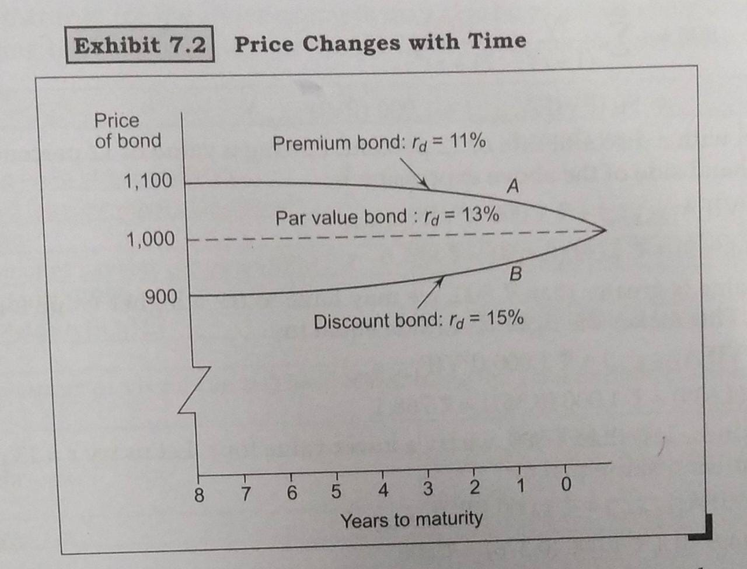

Slide 13
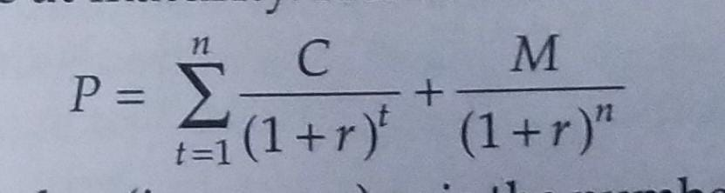
If the required yield does not change between now and maturity date, the premium will decline over time as shown in curve A. Similarly the discount too will decline over time as shown by curve B.
Current Yield of the Bond = Annual Interest.
Price
Yield to Maturity(YTM):
The YTM of a bond is the interest rate that makes the present value of the cashflows receivable from owning the bond equal to the price of bond.
Note: YTM is the rate(r) at which RHS = Market Price of the bond

Slide 14
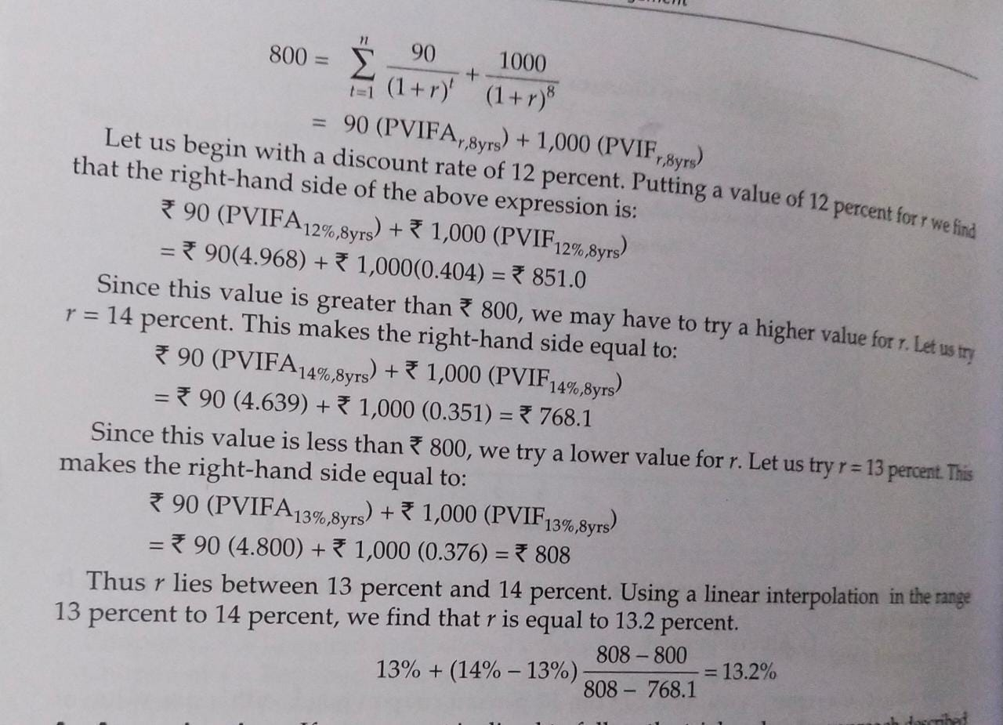
The computation of YTM requires trial and error procedure.
For example:
A bond of ₹ 1000 par value bond, carrying a coupon rate of 9%, maturing after 8 years. The bond is currently selling for ₹ 800. what is YTM of bond?

Slide 15
YTM on a bond ( An approximation):
YTM ≈ C + (M-P) / n
0.4M + 0.6P
YTM = 90 + (1000 – 800)/8
0.4 x 6000 + 0.6 x 800
= 13.1%
Yield to Call (YTC) : Some bonds carry a call feature that entitles the issuer to call (buy back) the bond prior to the stated maturity date in accordance with a call schedule (which specifies a call price for each call date).
Calculation of YTC is similar to YTM where M is the call price (in rupees) and n is the number of years until the assumed call date.

Slide 16
Exercise:
The Market value of a Rs. 1000 par value bond, carrying a coupon rate of 12% and maturing after 7 years, is Rs. 750. What is the yield to maturity of this bond? ( Ans : 18.70%)
2. The Market value of a Rs. 100 par value bond, carrying a coupon rate of 14% and maturing after 10 years, is Rs. 80. What is the yield to maturity of this bond? (Ans : 18.56%)
3. The market price of a Rs. 1000 par value bond carrying a coupon rate of 14% and maturing after 5 years in Rs. 1050. What is YTM on this bond? What is the approximate YTM? (Ans : 12.60% , 12.62%)
4. You can buy a Rs. 1000 par value bond carrying an interest rate of 14% (payable annually) and maturing after 4 years for Rs. 900. If the reinvestment rate applicable to the interest receipts from this bond is 16%, what will your yield to maturity? ( Ans: 19.94%)
5. A Rs. 100 par value bond bearing a coupon rate of 12% will mature after 5 years. What is the value of the bond if discount rate is 15%?
( Ans : Rs.89.924 )

Slide 17
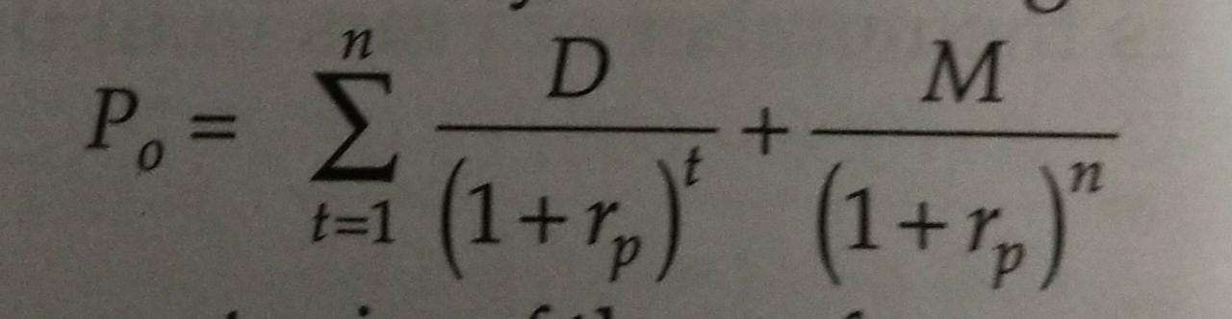
VALUATION OF PREFERENCE STOCK:
Preference stock generally pays regular, fixed dividends.
Preference dividends are not increased when the profits of the firm rise, nor are they lowered or suspended unless the firm faces financial difficulties.
If preference dividends are cut or suspended for sometime, the firm normally required to pay arrears before paying equity dividends.
Preference stock may be perpetual or redeemable.

Slide 18
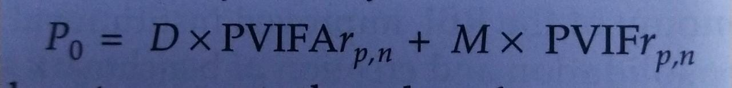
Present Value of an ordinary annuity:
Compute the value of preference stock, consider an 8 year, 10% preference stock with a par value of Rs. 1000. The required rate on this preference stock is 9%.
P = 100 X PVIFA _{(9%, 8yrs)} +1000 X PVIF _{(9%, 8yrs)}
= 100 X 5.535 + 1000 X 0.502 = Rs. 1055.5

Slide 19
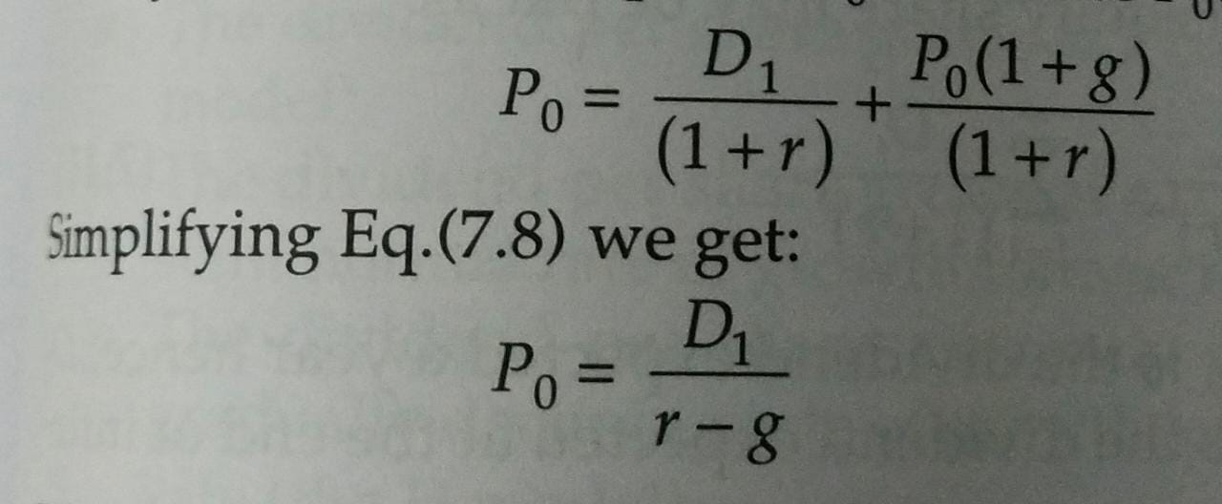
EQUITY VALUATION:
Single – Period Valuation Model (Constant growth model)

Slide 20
Example: Prestige’s equity share is expected to provide a dividend of Rs. 2 and fetch a price of Rs. 18 a year hence. What price would it sell for now if investor’s required rate of return is 12 %? The current price will be:
P₀ = 2.0 + 18.00 = Rs. 17.8
(1.12) (1.12)
Example: The expected dividend per share on the equity share of Roadking Limited is Rs. 2. The dividend per share has grown over the past 5 years at the rate of 5% per year. This growth rate will continue in future. What is the intrinsic value of equity share if the required rate is 15% ?
P0 = 2.00 = Rs. 20.00
0.15 – 0.05
Expected rate of return:
r = (D₁ / P₀ )*100+ g
The expected dividend per share of Vaibhav Limited is Rs. 5. The dividend is expected to grow at the rate of 6% per year. If the price per share is Rs. 50, what is the expected rate of return?
r = (5/50)*100 + 6%= 16%

Slide 21
Exercise :
The share of a certain stock paid a dividend of Rs. 2 last year (D₀ = 2). The dividend is expected to grow at a constant rate of 6% in future. The required rate of return on this stock is considered to be 12%. How much should this stock sell for now? ( Ans : 35.33)
Shenoy Corporation’s previous dividend was Rs. 12. Earnings & Dividends are expected to grow at the rate of 10%. The required rate of return on the stock is 15%. What should be the market price of stock now? ( Ans : Rs.264)
The equity stock of Max Limited is currently selling for Rs. 32 per share. The dividend expected next is Rs. 2. The investors required rate of on this stock is 12%. Assume that constant growth model applies to Max Limited. What is the expected rate of Max Limited? (Ans : 5.75%)
Fizzle Limited is facing gloomy prospects. The earnings and dividends are expected to decline at the rate of 4%. The previous dividend was Rs.1.50. If the current market price is Rs. 8, what rate of return do investors expect from the stock of fizzle limited? (Ans : 14% )

Slide 22
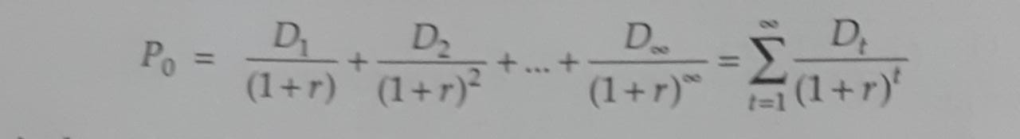
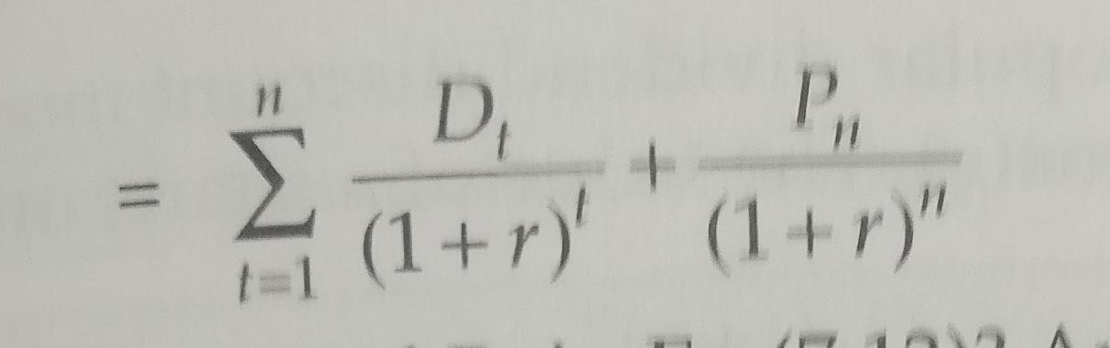
Multi – period Valuation model:
The above formulae shows valuation of equity shares giving dividend for infinite duration.
P₀
The above formulae shows the valuation of equity share for finite horizon

Slide 23
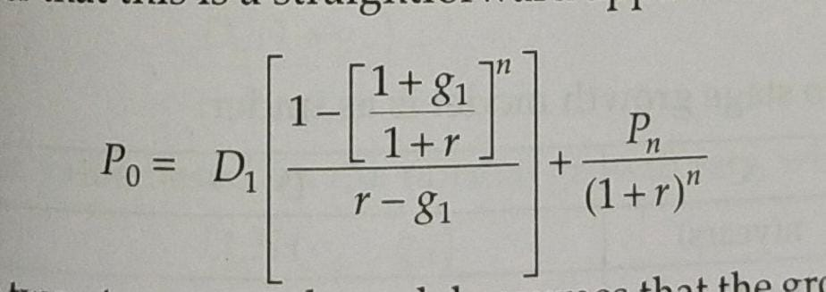
Zero Growth Model: If Dividend per share remains constant year after year at a value of D, it becomes:
P₀ = D
r
Two Stage Growth Model:
Where,
P_{n} = D_{n+1}
r – g₂

Slide 24
Example:
The current dividend on an equity share of Vertigo Limited is Rs. 2. Vertigo is expected to enjoy an above – normal growth rate of 20% for a period of 6 years . Thereafter the growth rate will fall and stabilise at 10%. Equity investors require a return of 15%. What is the intrinsic value of the equity share of Vertigo?
g1 = 20%
g2 = 10%
n = 6 years
r = 15 %.
D1 = D0 (1+g1) = 2(1+0.20) = 2.40
P0 = 2.40 [ 1-(1.2/1.15)^6]/[0.15-0.20] + [2.40 (1.20)^5(1.10)]/[0.15-0.10] *[1/(1.15)^6]
= 2.40 [ (1- 1.291) / -0.05 ] + [ 2.40(2.88)(1.10)]/.05 * [0.432]
=13.96 + 56.80
= Rs. 70.76

Slide 25
PERIOD | DIVIDEND | PVF @ 15% | PV OF CASHFLOWS
D1 | 2.4 | 0.869565217 | 2.086956522
D2 | 2.88 | 0.756143667 | 2.177693762
D3 | 3.456 | 0.657516232 | 2.272376099
D4 | 4.1472 | 0.571753246 | 2.37117506
D5 | 4.97664 | 0.497176735 | 2.474269628
D6 | 5.971968 | 0.432327596 | 2.581846568
 |  | Total | 13.96431764
D7 = (5.971968*1.10) = 6.569165
P6 = D7
r-g
P6 = 6.569165
(15% - 10%)
P6 =6.569165 /0.05 = 131.3833
Rs. 131.3833 is the price at the end of 6th year
PV of 131.3833 = P6 * PVIF of 6th year @ 15%
=131.3833 * 0.432327596 = 56.8006245
Therefore Price of the share at present = 13.964318 + 56.8006245
= 70.76

